Slide 1
Brown Water Group
Nick Selby
David Steinhoff
Preston Culbertson
Santiago Vivanco
ME 4182-F
April 25, 2016

Slide 2
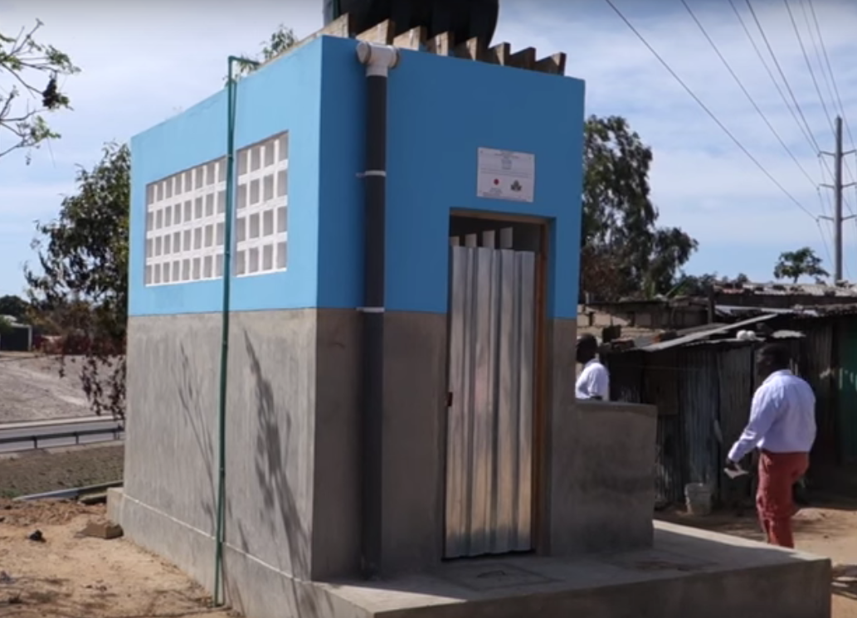
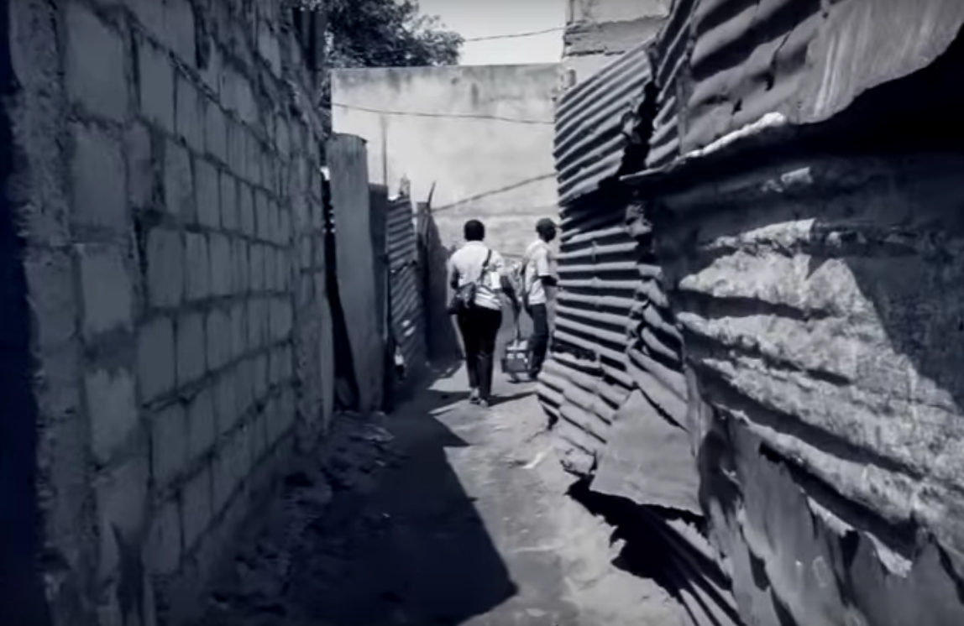
Design Problem and Motivation
Purpose:
Measure population density for MAPSAN, a study aiming to quantify health gains from sanitation interventions
Problem:
Ground-based methods are ineffective in crowded slums
Existing aerial photography lacks needed resolution

Slide 3
Design Problem and Motivation
Deliverable: Turnkey Aerial Imaging System
Hardware:
Platform capable of imaging large areas
Software: Mission Planning + Processing Application
Plans flights for desired area
Creates composite aerial photo
Measures “real” distances from photo
Market:
Researchers/academic studies (e.g. MAPSAN)
Governments/NGOs
Residents of informal communities

Slide 4
Engineering Requirements
Drone Requirements
Horizontal travel >= 1 km
Mission time <= 30 min/compound
Cost < $6000
100% of trained staff able to use without error
Stored energy >= 3 Ah
Load capacity >= 400 g
Top Speed >= 25 mph
Mass < 2 kg
Flight height < 200 ft., > 15 ft.
Radio range >= 1 km
Wind Speed 10 mph
Camera Requirements
Field of view >= 70 m
Identify features >= 8 in.
Linear resolution >= 3000 pixels
Battery life >= 22 min
Working Distance >=200 ft.
Resolution >= 12 MP
Focal Length <= 14mm
Sensor Size 1 in.
Electronics Requirements
Geotag accuracy <= 1 m
Computation time < 5s
Failsafe features
Sensor bits >= 10 Bits
System Requirements
Flight time >= 12 min
Hover time >= 15 min
Work in wind speeds <= 10 mph
Complete mission after losing control signal for 25 sec

Slide 5
Design: Software
User Selects Flight Area
Software Generates Flight Paths
User Uploads Flight Paths to Drone
Drone Maps Area
Software Stitches Map
Software Generates Area

Slide 6
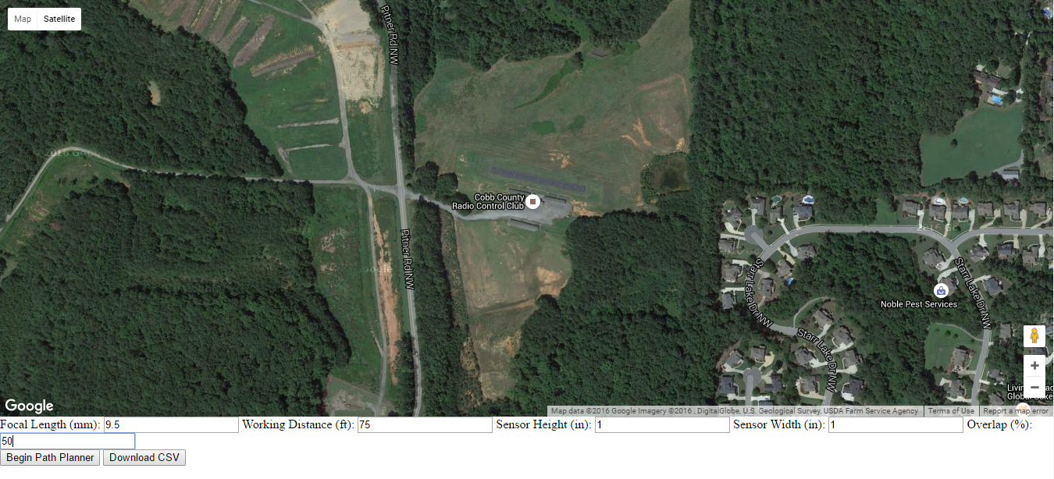

User Selects Flight Area
Software Generates Flight Paths
User Uploads Flight Paths to Drone
Drone Maps Area
Software Stitches Map
Software Generates Area
Fill in Photography Specifications
Click “Begin Path Planner”

Slide 7
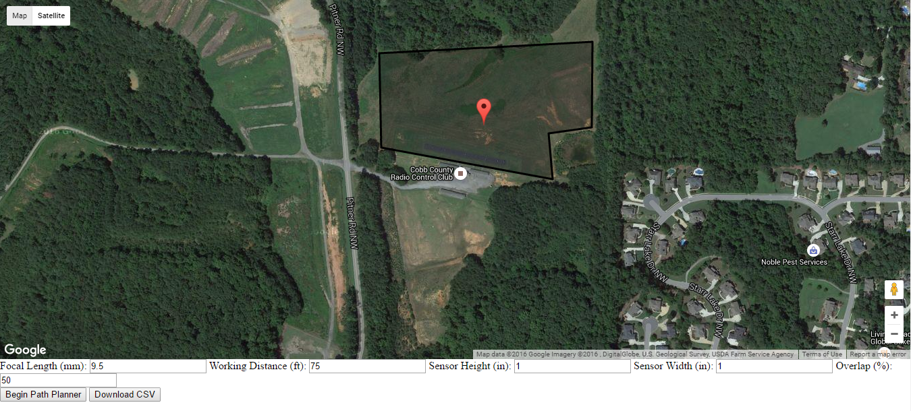
User Selects Flight Area
Software Generates Flight Paths
User Uploads Flight Paths to Drone
Drone Maps Area
Software Stitches Map
Software Generates Area
Draw Polygon and Select Home Point
Click “Download CSV”

Slide 8
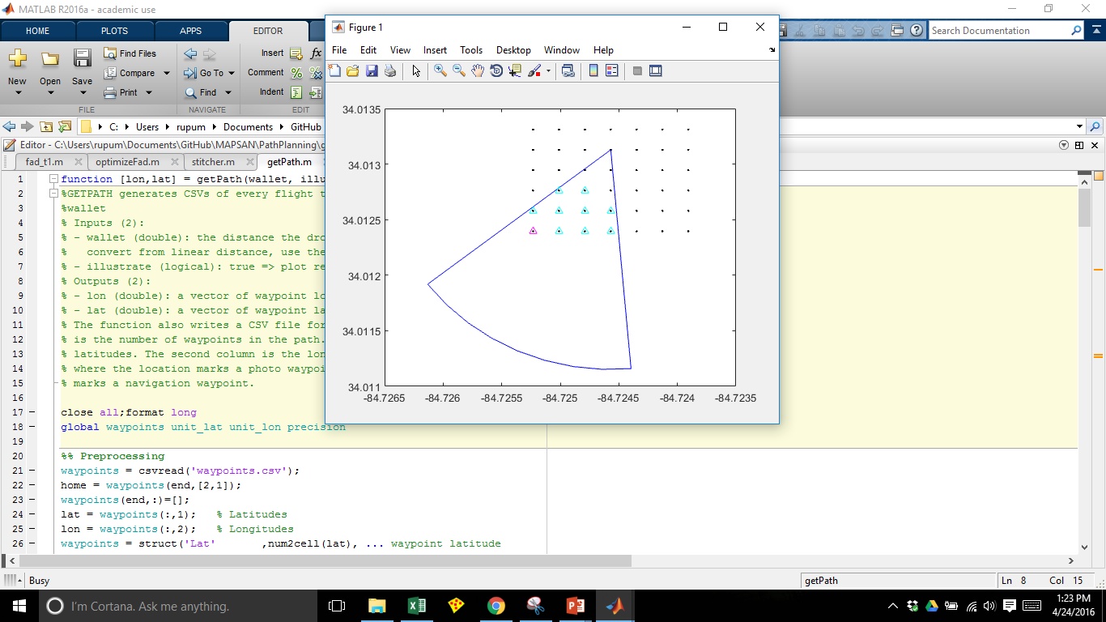
User Selects Flight Area
Software Generates Flight Paths
User Uploads Flight Paths to Drone
Drone Maps Area
Software Stitches Map
Software Generates Area

Slide 9
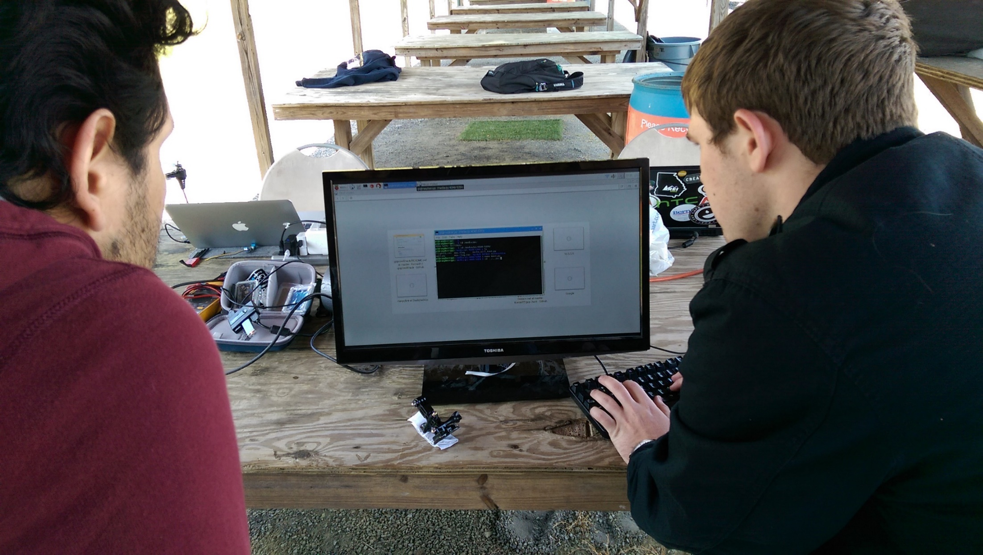
User Selects Flight Area
Software Generates Flight Paths
User Uploads Flight Paths to Drone
Drone Maps Area
Software Stitches Map
Software Generates Area

Slide 10
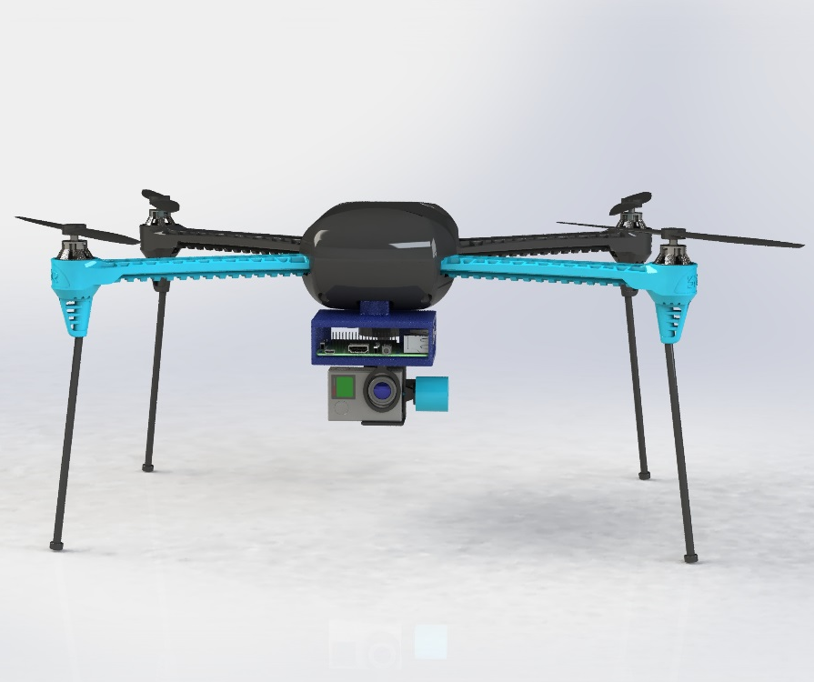
User Selects Flight Area
Software Generates Flight Paths
User Uploads Flight Paths to Drone
Drone Maps Area
Software Stitches Map
Software Generates Area

Slide 11
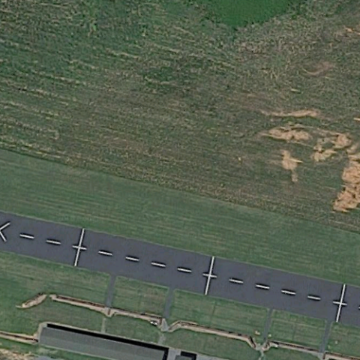
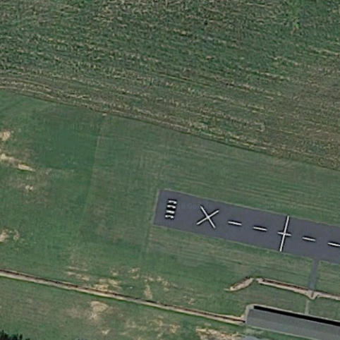
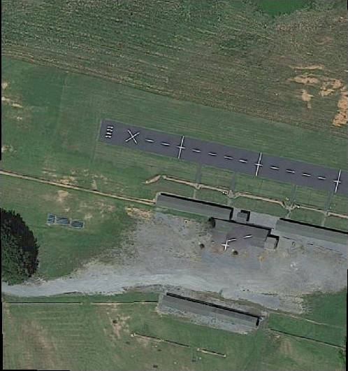
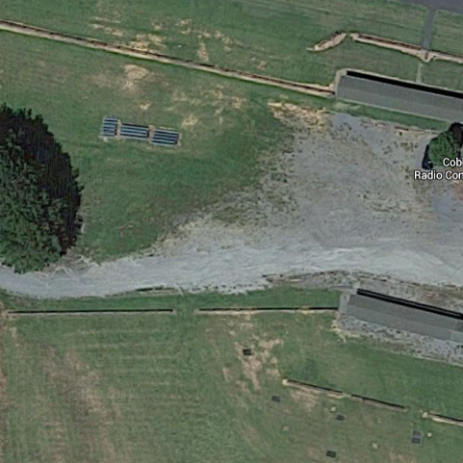
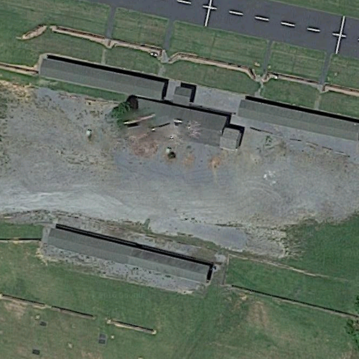
User Selects Flight Area
Software Generates Flight Paths
User Uploads Flight Paths to Drone
Drone Maps Area
Software Stitches Map
Software Generates Area

Slide 12
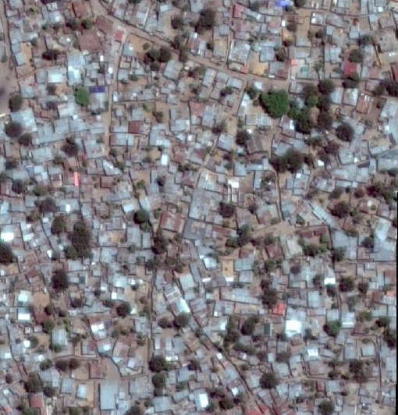
User Selects Flight Area
Software Generates Flight Paths
User Uploads Flight Paths to Drone
Drone Maps Area
Software Stitches Map
Software Generates Area

Slide 13
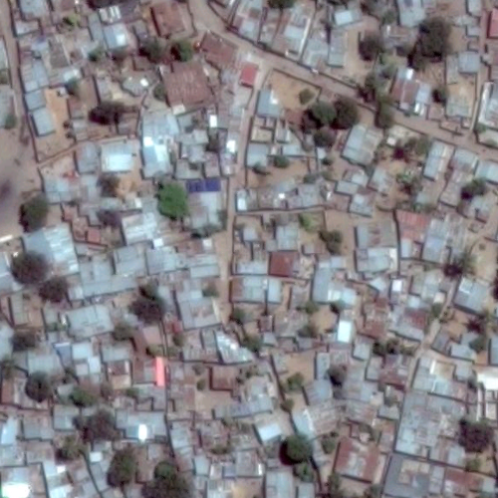
User Selects Flight Area
Software Generates Flight Paths
User Uploads Flight Paths to Drone
Drone Maps Area
Software Stitches Map
Software Generates Area
Compound | Area (m²) | Residents | Population Density (people/m²)
1 | 59 | 7 | 0.118
2 | 67 | 6 | 0.089
…

Slide 14
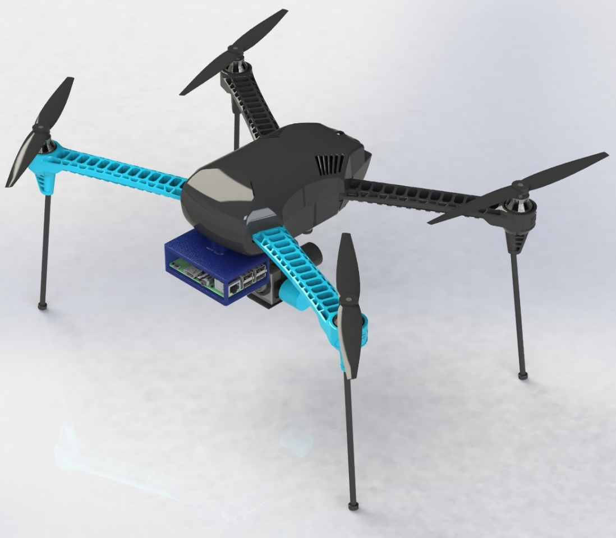
Design: Hardware

Slide 15
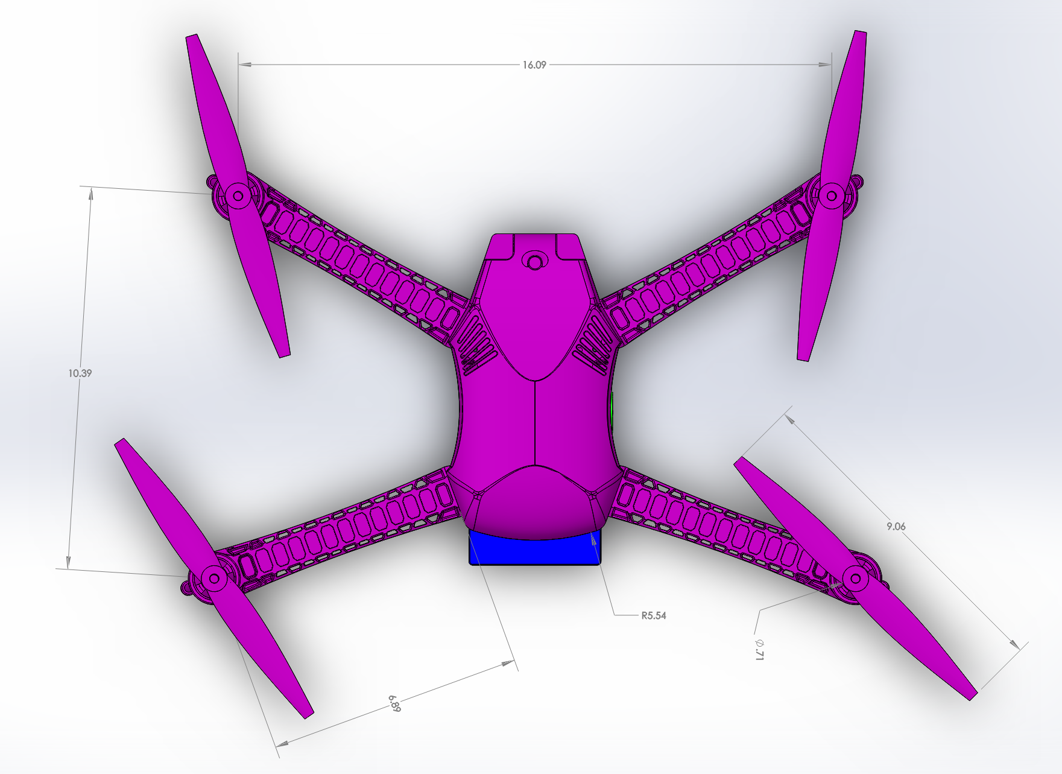
Hardware: Dimensions
16.09”
10.39”
9.06”

Slide 16
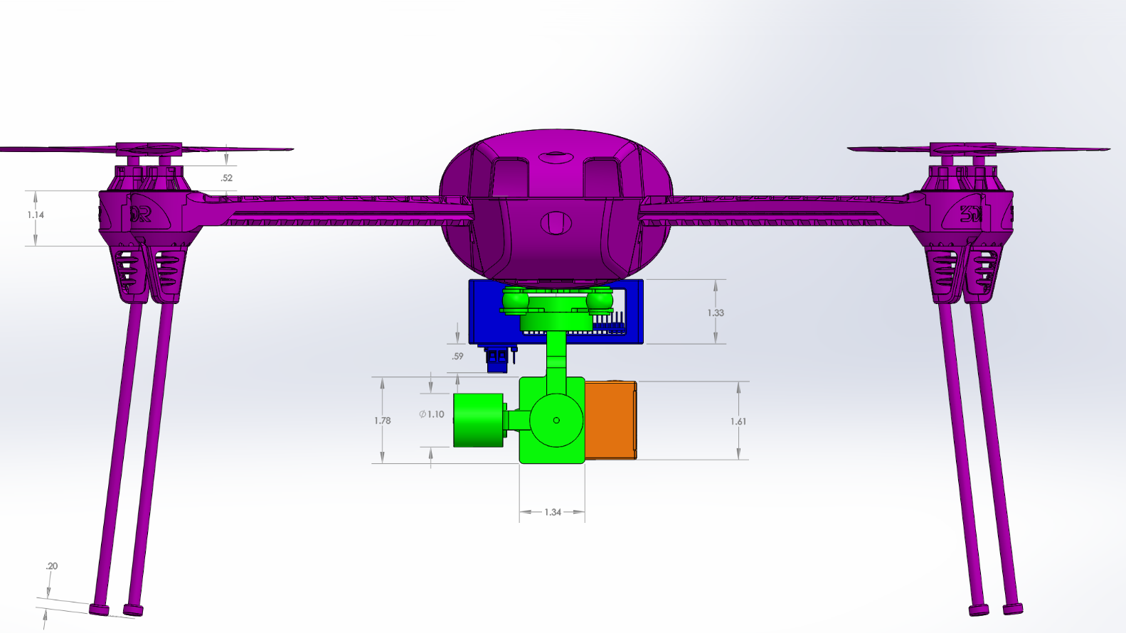
Hardware: Dimensions
~14”

Slide 17
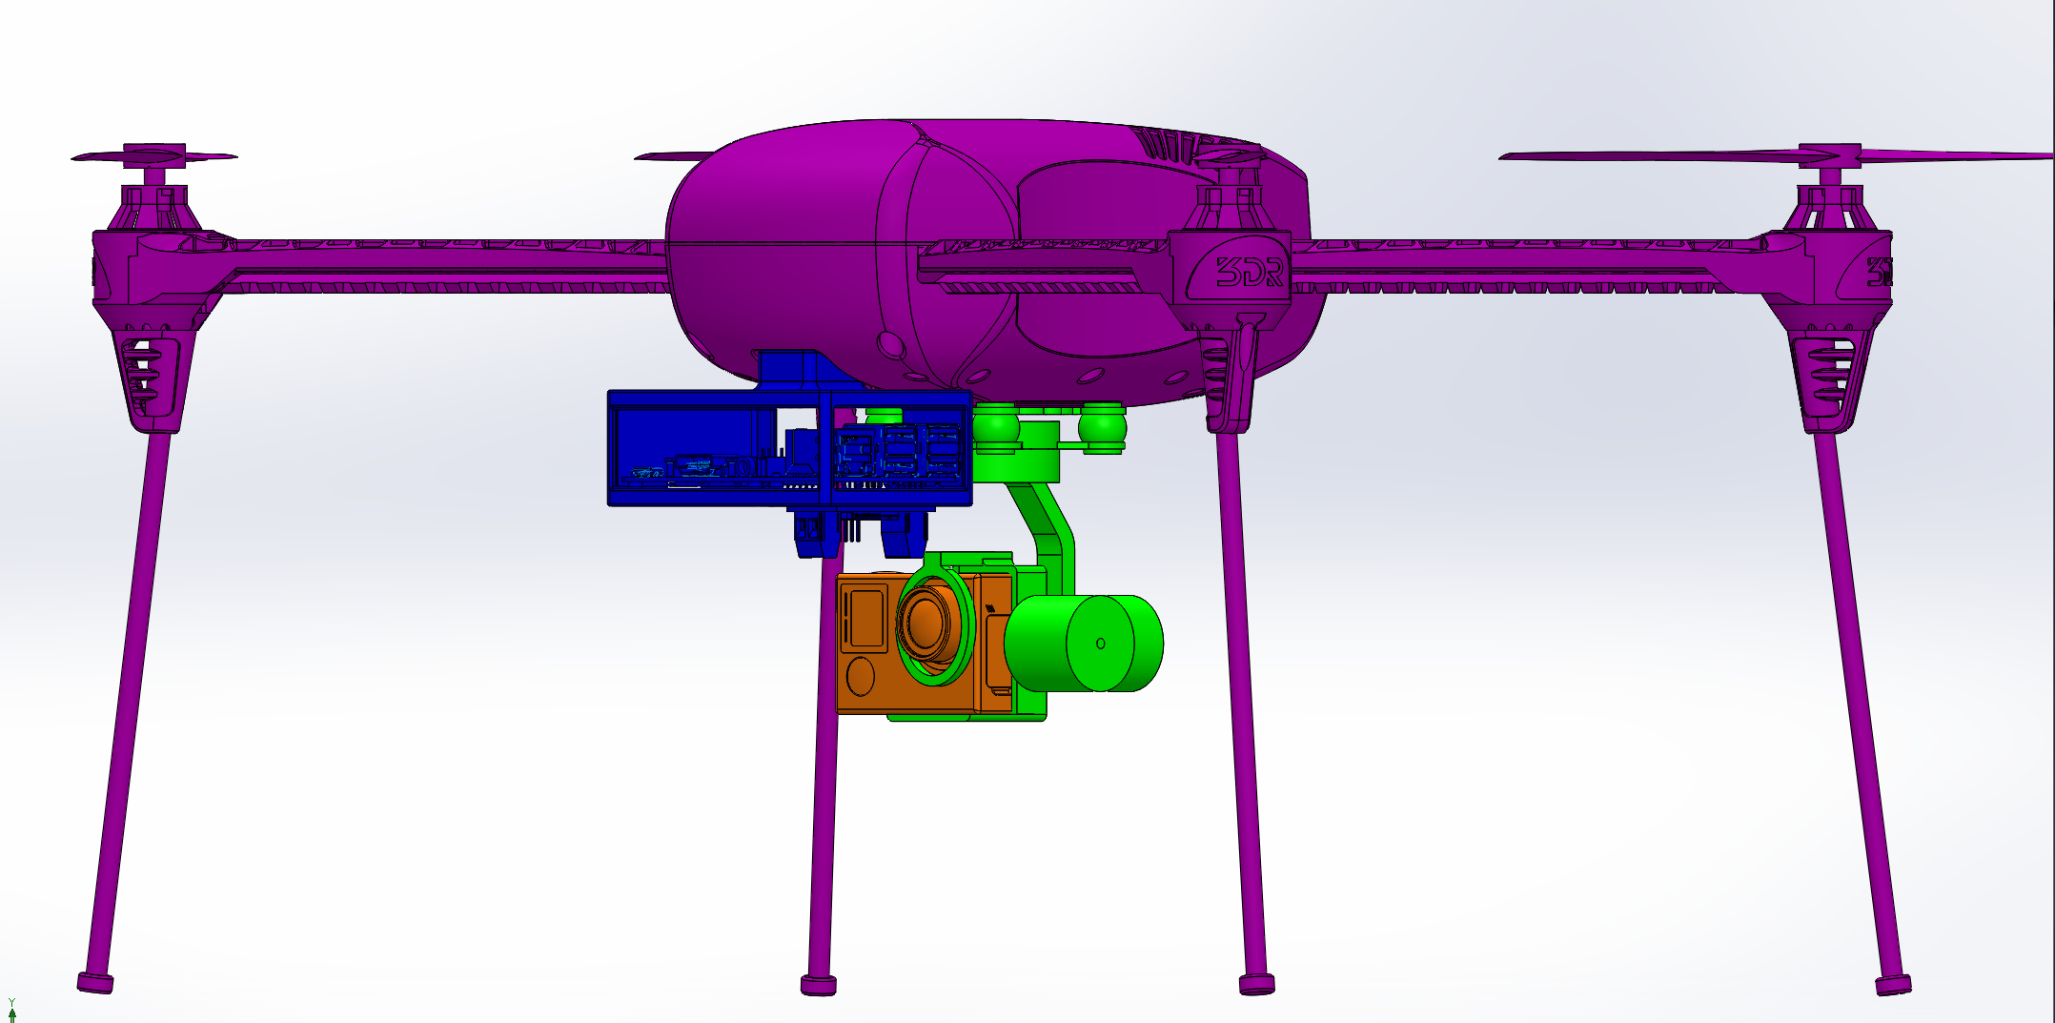
Hardware: Subsystems
Drone
Controller
Camera
Gimbal

Slide 18
Subsystems: Drone
3DR IRIS+
5100 mAh Battery
Built-in GPS

Slide 19
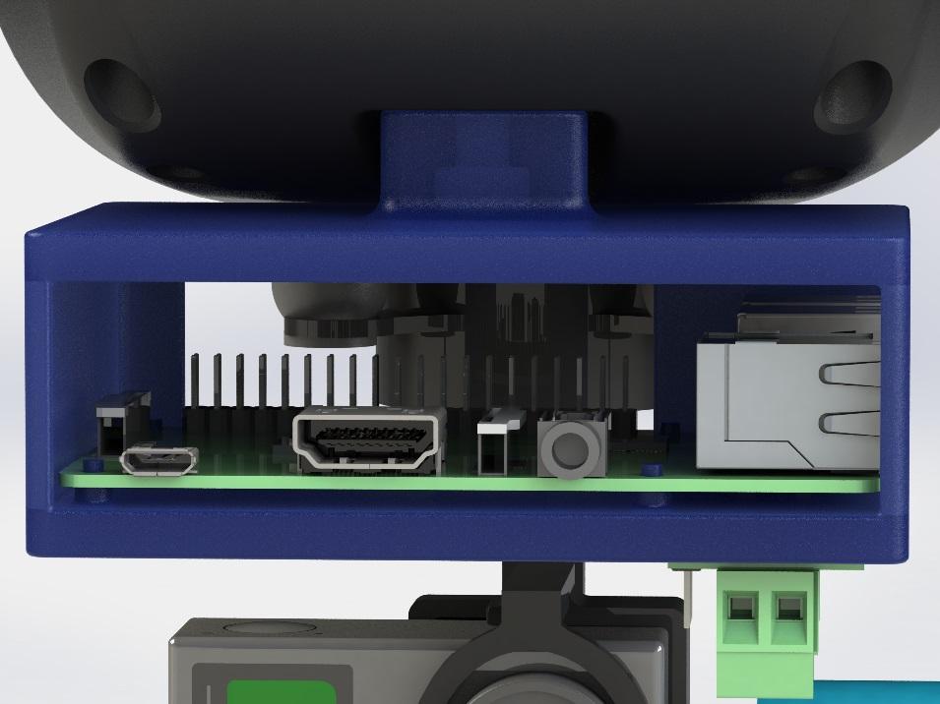
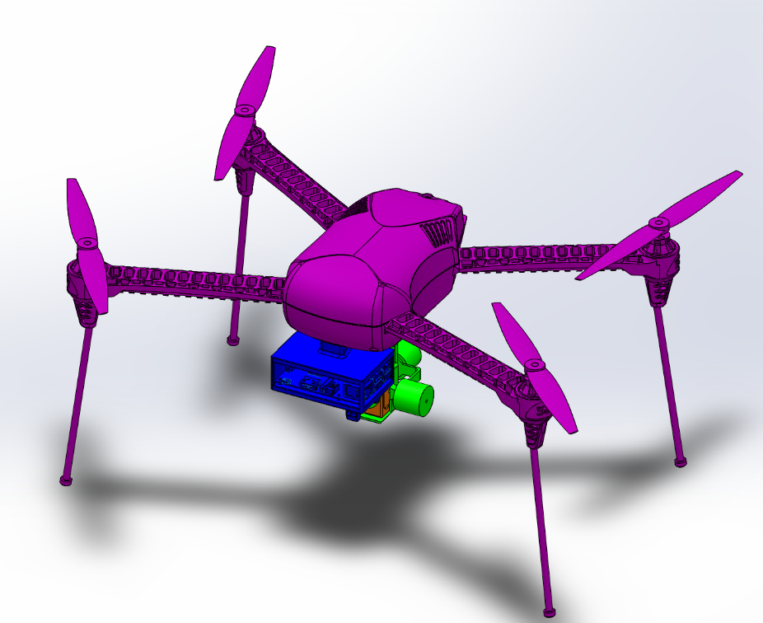
Subsystems: Controller
Open Source
Wi-Fi Enabled
Raspberry Pi 2
+
Custom Mount

Slide 20
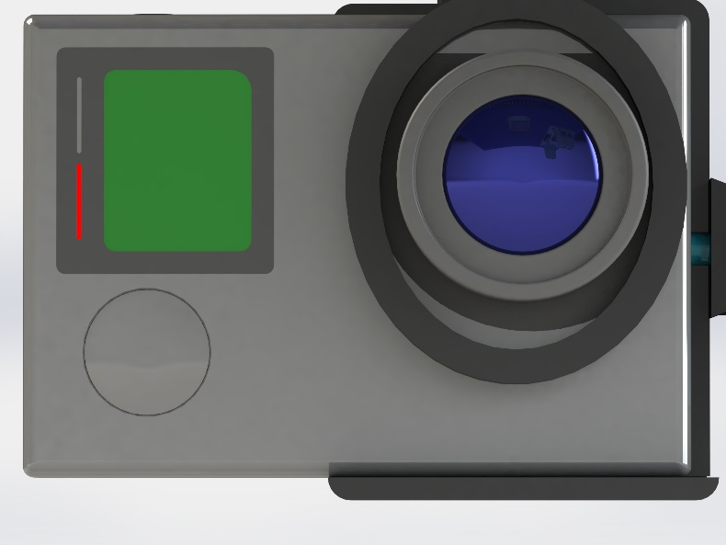
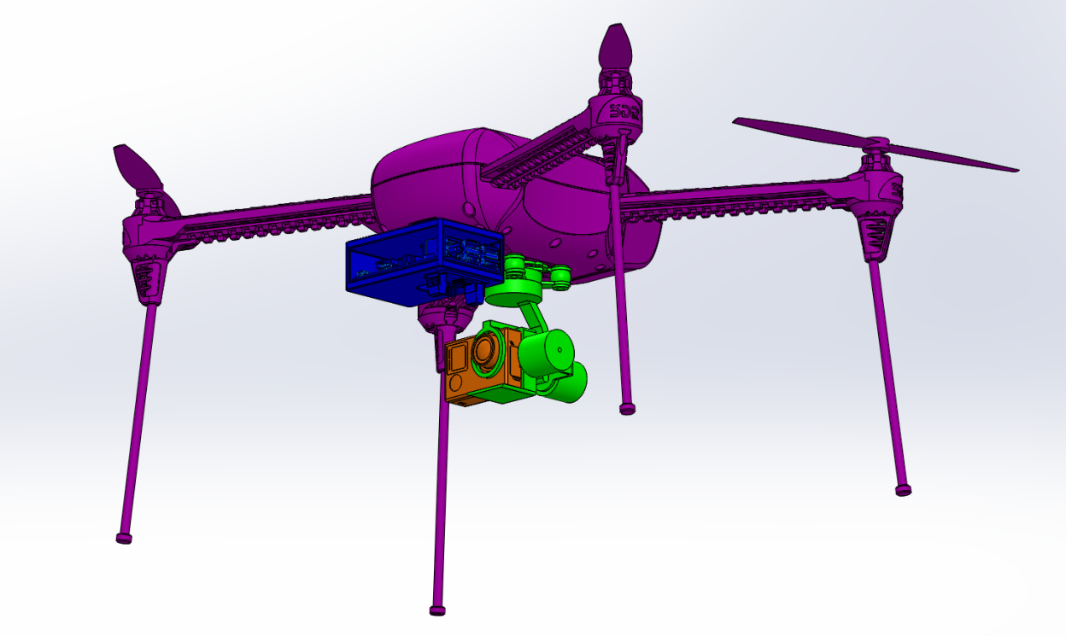
Subsystems: Camera
12 MP Resolution
Remote Controllable
Lightweight
GoPro Hero 4

Slide 21
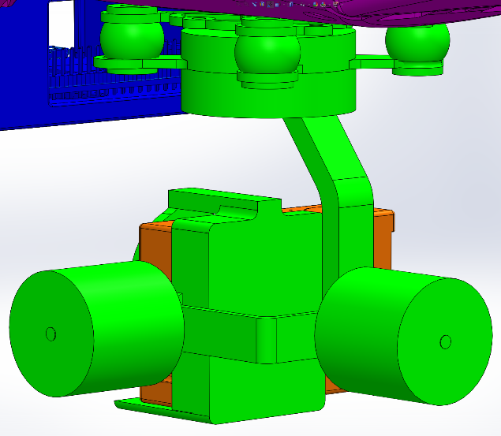
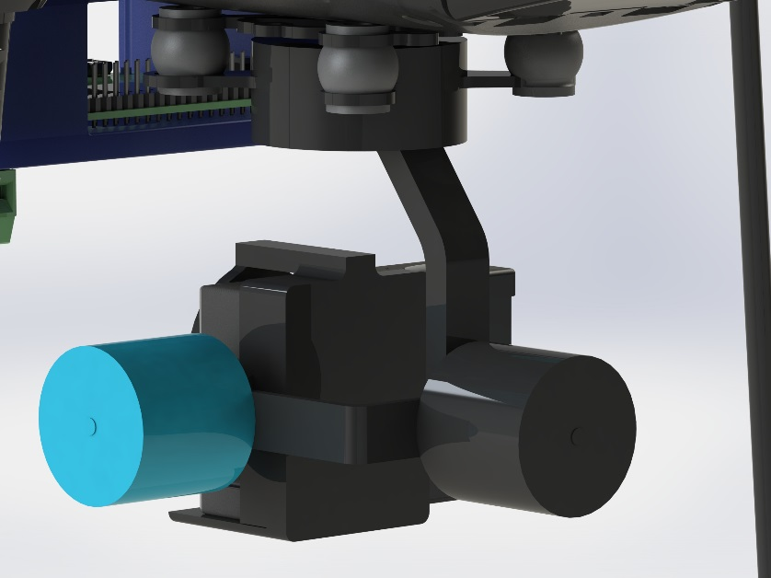
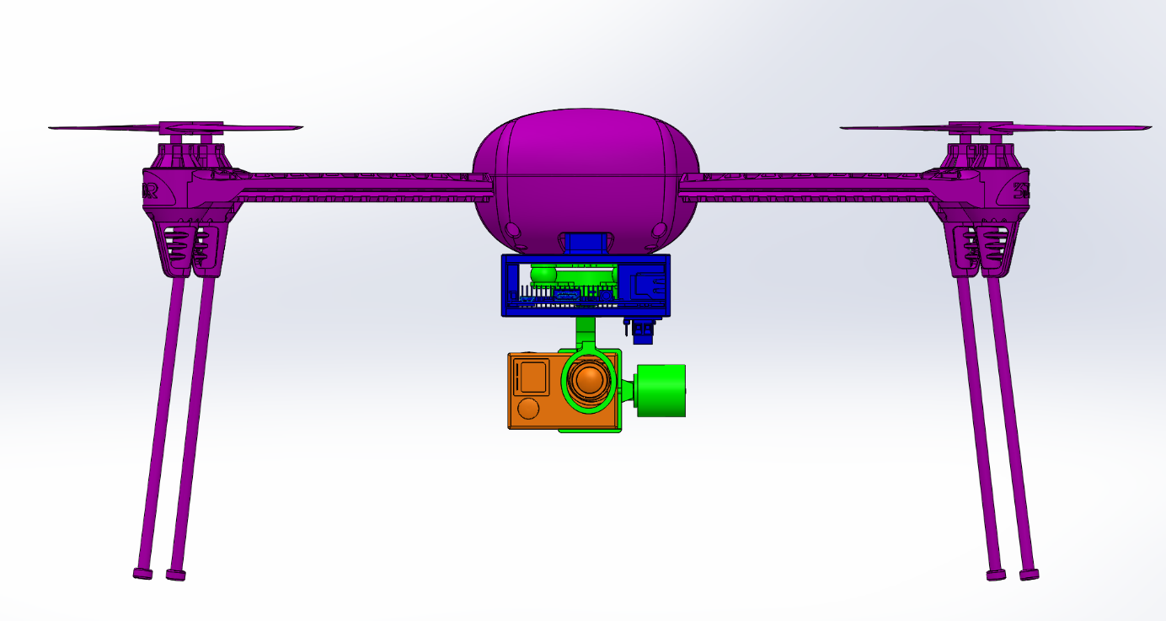
Subsystems: Gimbal
Tarot T-2D
2-Axis Stabilization
Designed for Drone

Slide 22
Hardware: Mass Budget
Part | Mass (g) | Quantity | Mass Total (g) | Max Payload (g) | Payload Remaining (g)
3DR IRIS+ | - | 1 | - | - | -
Extended Legs | - | 1 | - | - | -
Battery | - | 1 | - | - | -
TOTAL | 1282 | 1 | 1282 | - | -
GoPro Hero4 | 89 | 1 | 89 | 400 | 311
Raspberry Pi 2 | 40 | 1 | 40 | 400 | 271
Tarot T-2D Gimbal | 200 | 1 | 200 | 400 | 71
 |  |  | Mass Total (g) | Max Payload (g) | Payload Remaining (g)
 |  |  | 1611 | 400 | 71

Slide 23
Design: Bill of Materials
Part Name | Quantity | Cost | Total
3DR IRIS+ | 1 | $599.99 | $599.99
Tarot T-2D Gimbal | 1 | $210.00 | $210.00
3DR IRIS+ Battery Pack | 6 | $39.99 | $239.94
GoPro HERO4 Black Edition | 1 | $499.99 | $499.99
microSD Memory Card 64 GB | 2 | $17.95 | $35.90
Raspberry Pi 2 | 1 | $40.00 | $40.00
HobbyKing™ Quattro 4x6S Lithium Polymer Multi Charger | 1 | $99.99 | $99.99
HobbyKing 350w 25A Power Supply (100v~120v) | 1 | $43.94 | $43.94
Charge Cable w/ Male XT60 <-> 4mm Banana plug | 4 | $3.23 | $12.92
Cables Unlimited 6-feet Mickey Mouse Power Cord | 1 | $4.49 | $4.49
 |  | Total (w/o tax) | $1,787.16

Slide 24
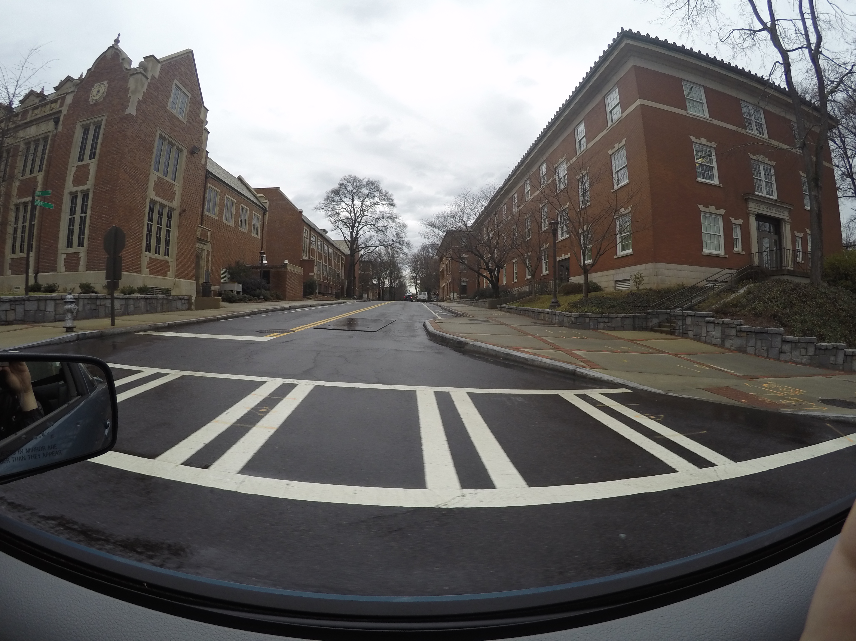
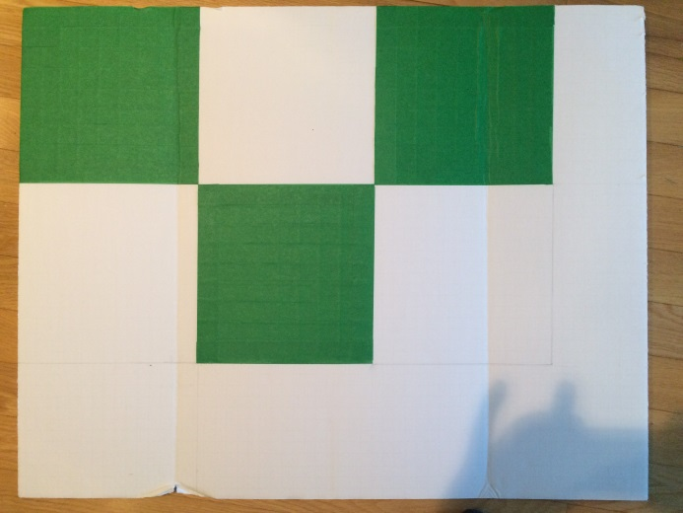
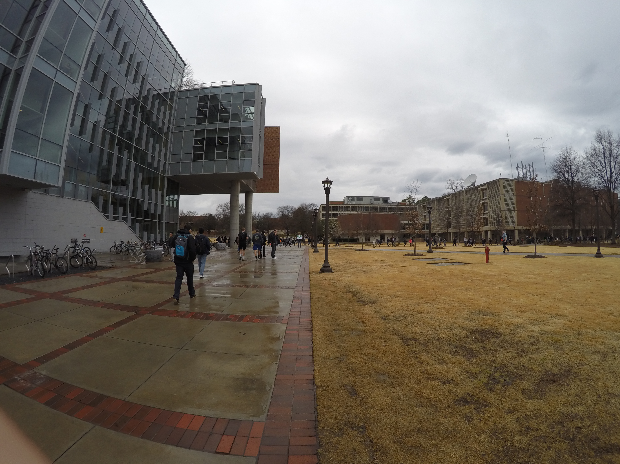
GoPro Validation
Confirmed GoPro Hero 4 satisfied resolution specification of <8 in. resolution at 200 ft
8 in. test pattern was distinguishable at 200 ft while stationary and moving at 25 mph
Test Pattern
Static Test
25 mph Test

Slide 25
Problems with Validation
FAA drone registration for academic use takes months
Georgia Tech’s overall Certificate of Authorization (COA) was only issued in April
Licensed RC pilot and lawyer required to be present for all drone flights
Test flights must occur at RC field 45 minutes from campus

Slide 26
Original Validation Plan
Test | Critical Details | Specification | Pass/Fail Criteria
Top Speed | Full loading, low wind | Top Speed >= 25mph | Meets Spec
Hover Time | Gimbal attached, medium winds, stop at 4000 mAh usage | Hover Time >= 15min | Hover flat at waypoint to 15min
Expected Battery Life | Full loading, medium wind, square path, stop at 15% | 12 min flight time per battery | Meets Spec
Max Range | Line of sight with drone at all times, low wind | Max range >= 1km unobstructed | Meets Spec
Max Wind Speed | Gimbal attached, high wind, 200 ft flight height | Works in wind speeds <= 10mph | Reasonably hit waypoints at different angles to the wind
Heartbeat | Heartbeat signal at 1Hz, timeout at 30s | Be able to lose contact with drone for short period and still complete mission | Fly full test path when controller is temp blocked
Camera Stability | Camera attached, actual height, actual Speed | 8 in. features must be visible during flight | >=1 pixel per test pattern square visible in picture

Slide 27
New Validation Philosophy
Engineering Problem
Design Concept
High Risk Path
Build and Test
Final Design
Engineering
Low risk path
Engineering Tools
Mathematics
Control Theory
Heat Transfer
Fluid Dynamics
Mechanics
Dynamics
Model, Analyze, and Verify
Learn about system
Course work

Slide 28
Final Validation Plan
Software-in-the-Loop simulation using jMAVSim
Attempt to perform complete system test with all hardware/software and all objectives
Troubleshoot failed subsystems
Repeat test and troubleshooting until all functions are operational
Where possible, validate specifications from flight data

Slide 29
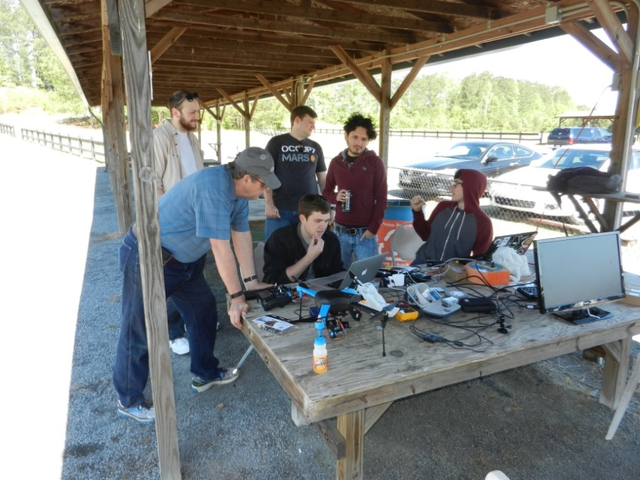
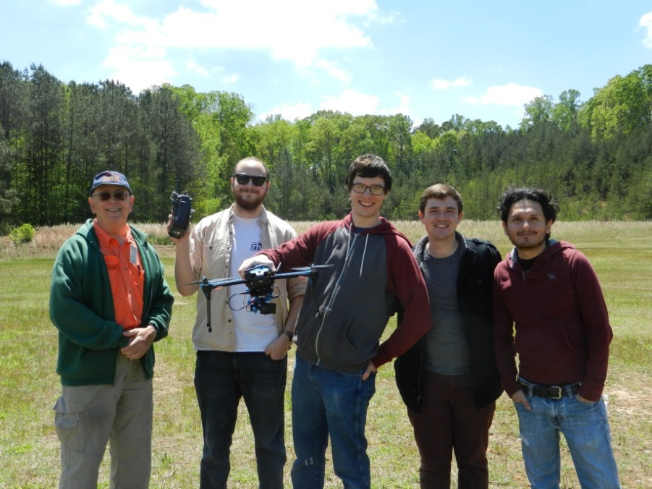
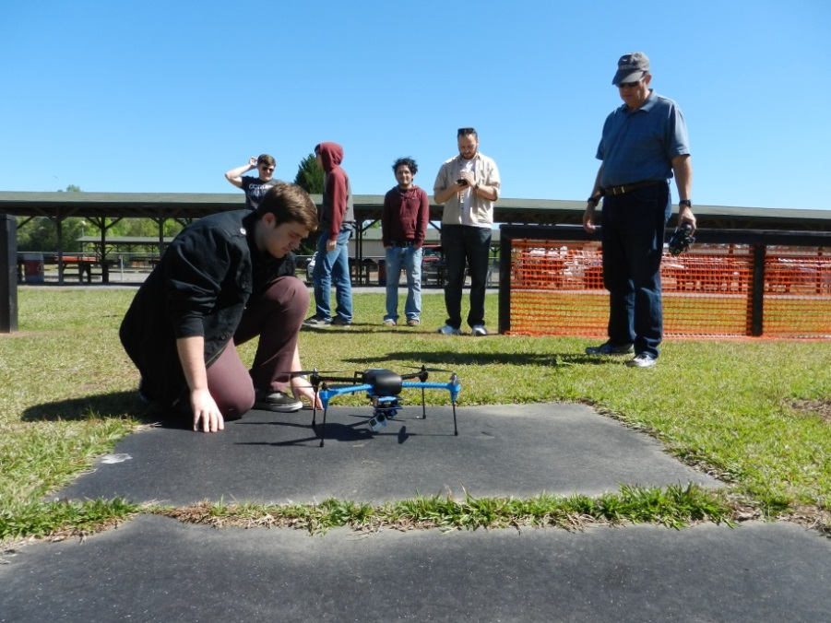
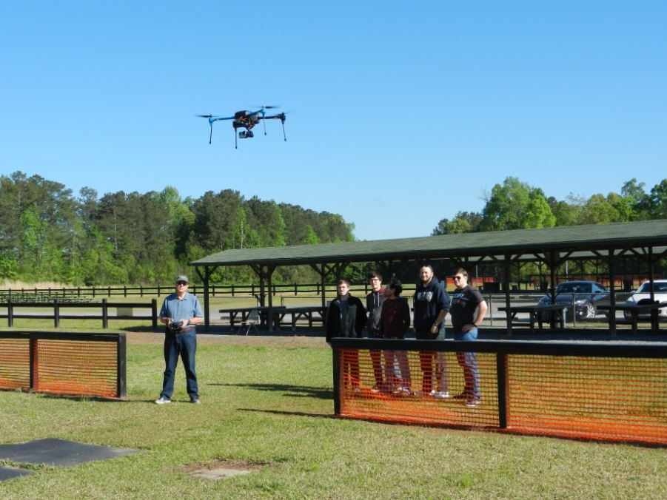
Testing

Slide 30
Validation Results
Specification | Validation Result | Explanation
Top Speed >25mph | PASS | Drone exceeded 25 mph multiple times
Hover Time >15min | PASS | Hover time was 15.5 minutes
12 min flight time per battery | PASS | Average flight time of each battery was ~15 minutes
Max range >1km unobstructed | INCONCLUSIVE | Field too small for test
Works in wind speeds <10mph | PASS | Wind speed during testing was 10 mph
Lose contact with drone for 20 sec and still complete mission | INCONCLUSIVE | Drone was not programmed with heartbeat timer
8 in. features must be visible during flight | INCONCLUSIVE | Gimbal manufacturing defect prevented aerial testing of camera

Slide 31
Future Specification Validation
Max range of >1 km unobstructed:
Plan: RC pilot recommended a large enough testing field for future testing
Lose contact with drone for 20 sec and complete mission:
Plan: repeat test with heartbeat code implemented
8 in. features must be visible during flight:
Plan: get replacement gimbal from manufacturer and repeat aerial test

Slide 32
Manufacturing: Assembly Instructions
Scope of project limited to delivery of one complete aerial imaging system
For assembly we will provide:
Instructions for mounting gimbal (from 3DR)
Instructions for mounting camera (from GoPro)
Instructions for mounting Raspberry Pi
Allen wrench set
All fasteners come included with drone
We want to provide electrical wiring instructions, but currently impossible with faulty gimbal

Slide 33
Future Work
Software improvements:
Improve UI design/ease of use
Implement “rally points” during loss of signal
Manufacturing:
Return faulty gimbal to manufacturer for repair
Validation:
Perform “full” validation, stitching drone-captured photos, calibrating distance measurement
Mission in Maputo

